Slide 1
Estimate The Presence of Impurities in Iron Ore Using IBM Watson Machine Learning
Aaditya gangavarapu
GITAM UNIVERSITY

Slide 2
INTRODUCTION
Iron ores are rocks and minerals from which metallic iron can be economically extracted. Iron is usually found in the form of Magnetite, Hematite, Goethite, Limonite, or Siderite.
Usually, Magnetite Iron ore concentrate contains an impurity of 3–7% of silica. Estimation of silica involves a lot of chemical analysis which is time-consuming and involves high operational cost. In order to cut down the operational cost and also to help engineers by predicting at a faster rate, we make use of Machine Learning (ML).
So the main goal of this project is to build a Machine Learning model to predict the impurities present in an Iron ore.

Slide 3
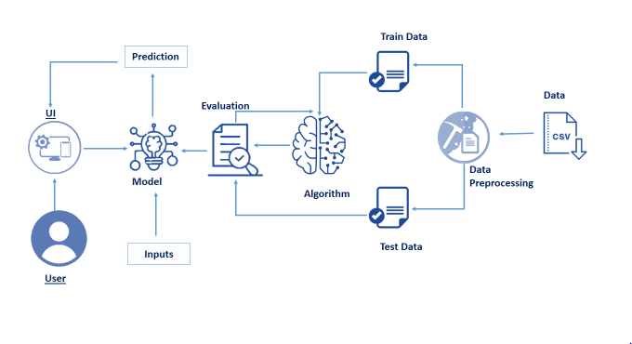
ARCHITECTURE

Slide 4
Project Flow
Machine Learning Model
Data Collection.
Collect the dataset or Create the dataset
Data Preprocessing.
Import the Libraries and the dataset.
Checking for Null Values.
Data Visualization.
Handling Missing Data.
Label encoding And One Hot Encoding.
Feature Scaling.
Splitting Data into Train and Test.
Model Building
Training and testing the model
Evaluation of Model
Application Building
Create an HTML file
Build a Python Code
UI
The user interacts with the UI (User Interface) to enter the data
Entered data is analyzed by the model which is integrated
Once the model analyses the input, the prediction is showcased on the UI

Slide 5
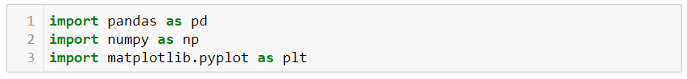
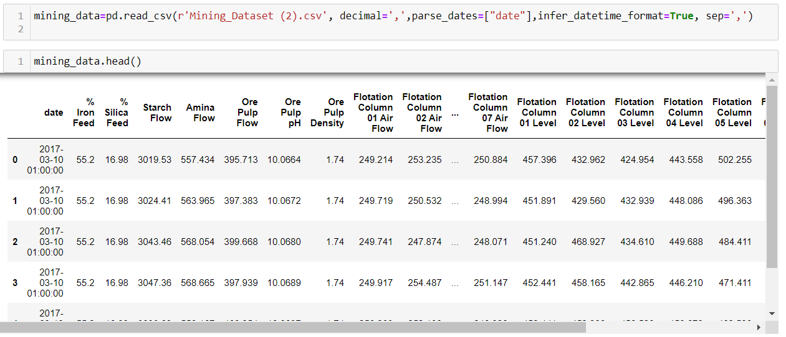
Machine Learning Model
→Importing Libraries
→Reading the dataset and Viewing the fields.

Slide 6
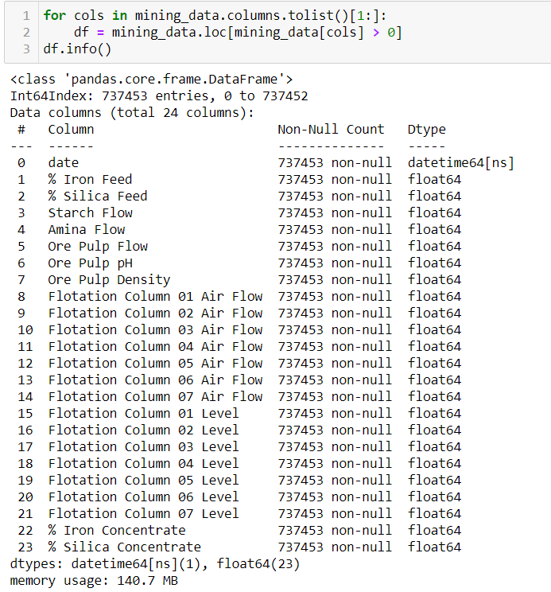
→Information about the
columns in the dataset

Slide 7
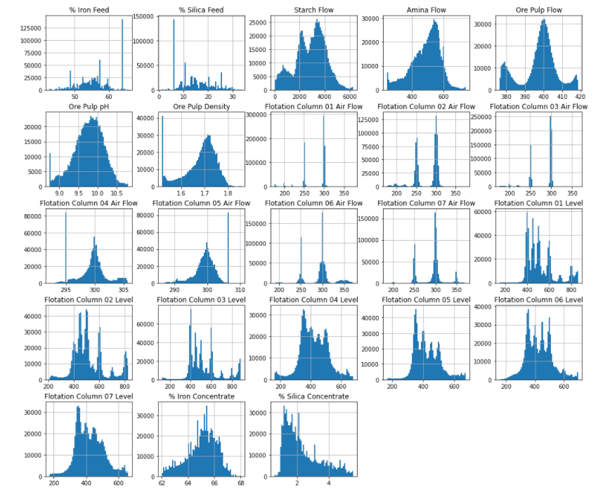
→Histogram Visualization of Columns

Slide 8
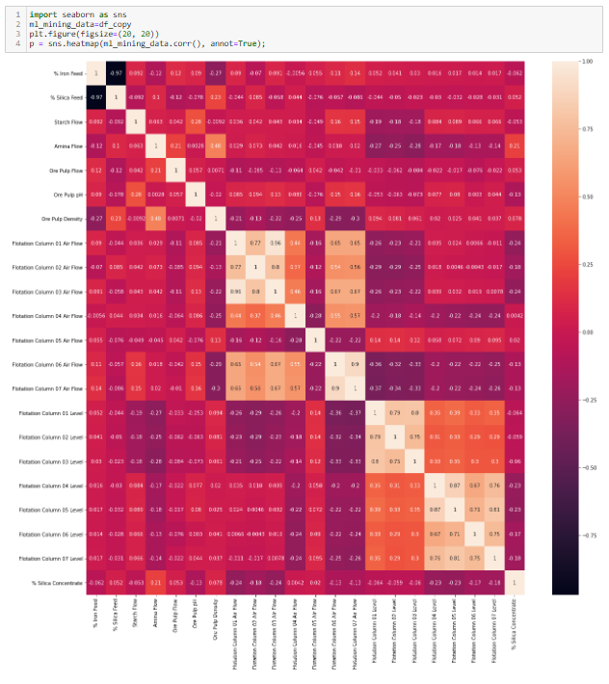
→HeatMap Visualization of Columns

Slide 9
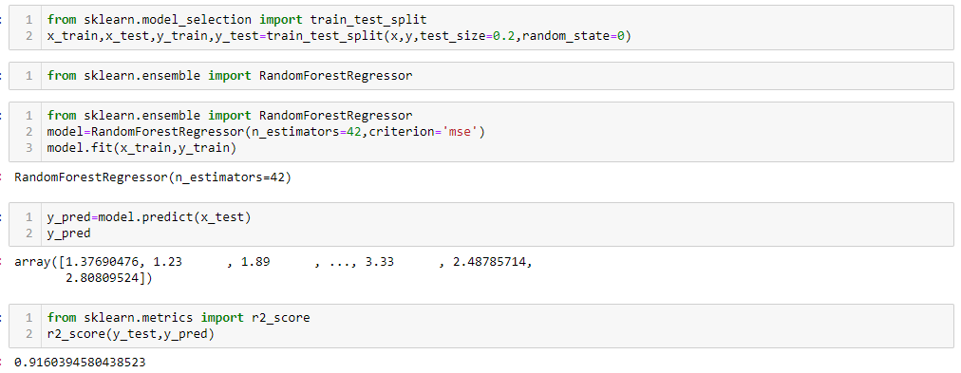
→Training and Splitting Data
→Applying Ensembled modelling and Predicting the accuracy of the Model

Slide 10
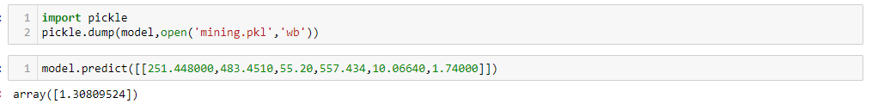
→Dumping the model
→Saving it as PKL file to access it in Flask

Slide 11
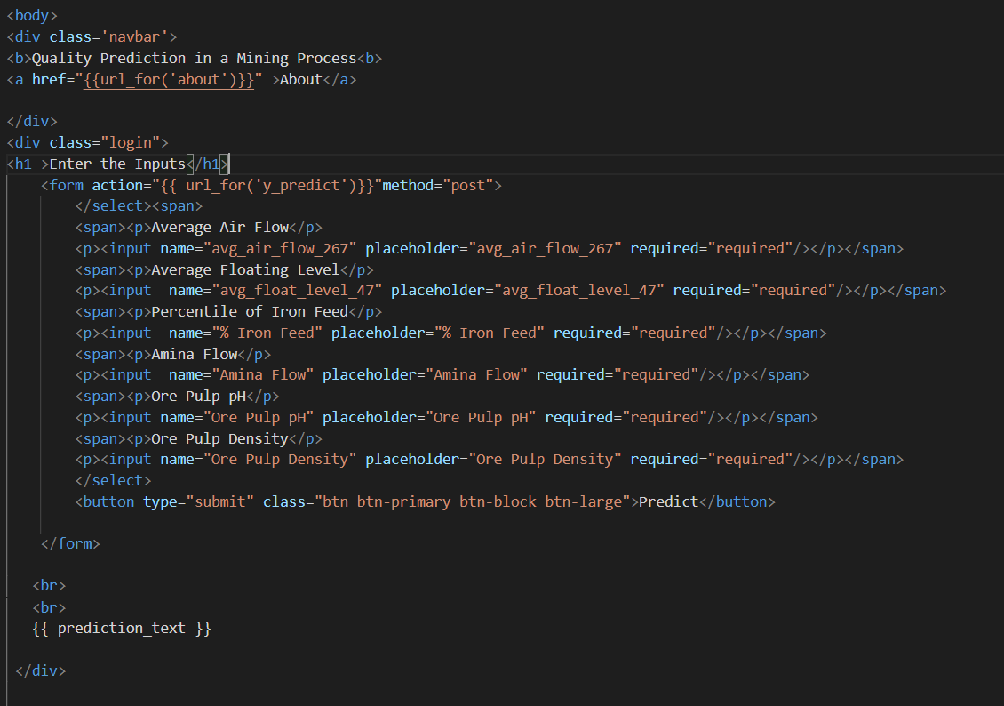
UI
→HTML FILE

Slide 12
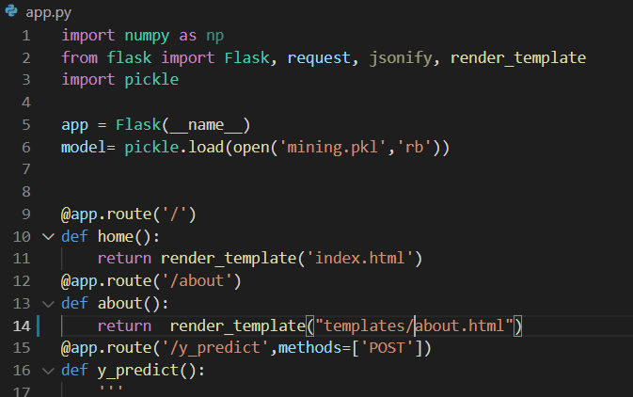
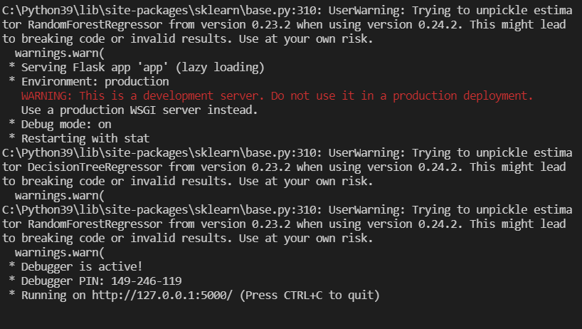
UI
→Creating a Flask Application and Accessing the Machine Learning Model
Running the Flask Application (Deployment)

Slide 13
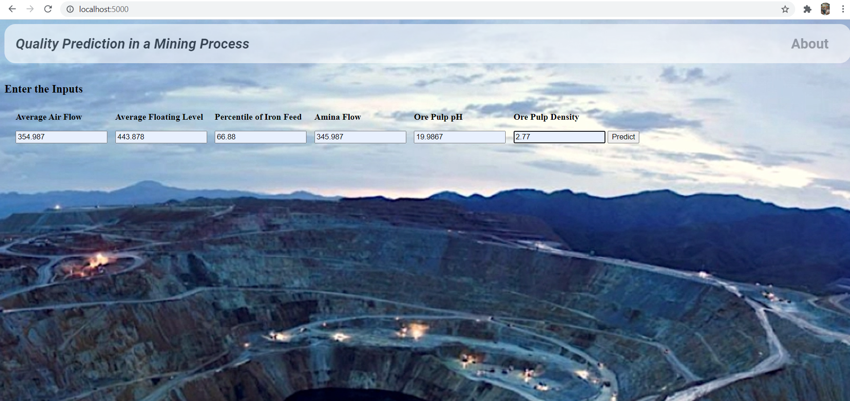
→Output UI and Percentages of the inputs.

Slide 14
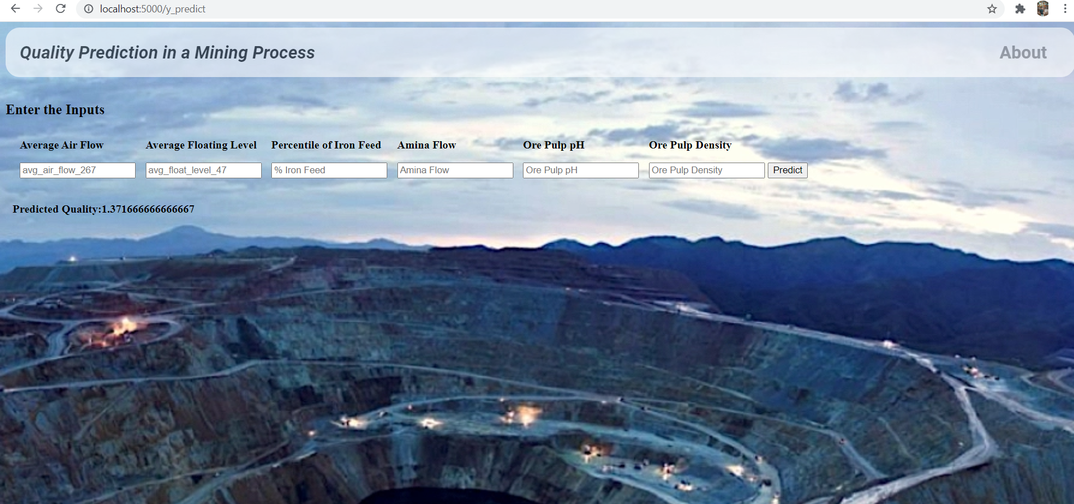
→Predicting The Quality.

Slide 15
